Slide 1
Computer System Activity Analysis
BIA 652
Prof. Khasha Dehnad A
Akshay Kumar Vikram
Parth Khadilkar
Saketh Patibandla
Sharvari Joshi
Notes:
Computer System Activity Analysis from System Performance measures

Slide 2

About the Data
CompActiv Dataset - Collection of computer system activity measures.
Data from Sun Sparcstation 20/712.
Tasks range from accessing the net to running cpu bound programs.
Collected on 2 occasions with system activity gathered every 5 seconds.
Final Dataset is taken from both occasions with equal number of observations from each collection epoch in a random order.
Data consists of 8192 records.
www.cs.toronto.edu/~delve/data/comp-activ/desc.html
Notes:
Source - A Regression dataset in Assessment category of Delve Datasets from the Computer science department of the University of Toronto.
128 Mb of memory - running in multi-user university department.

Slide 3
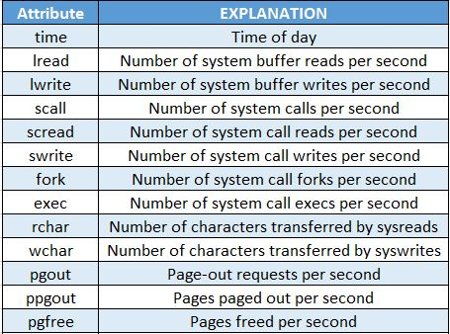
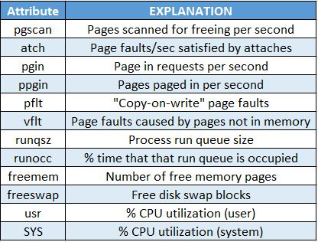
Dataset - Attributes

Slide 4
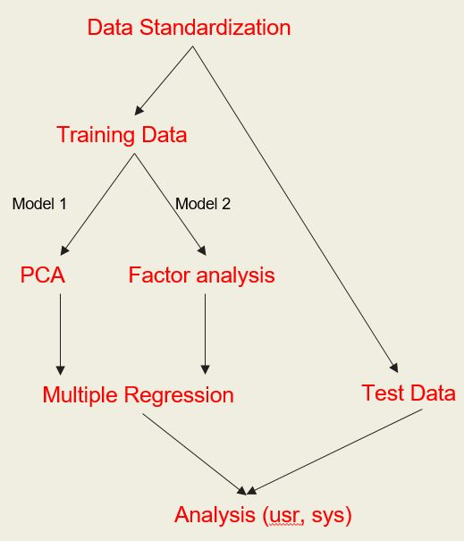
Method
Usr and sys are predicted separately.

Slide 5
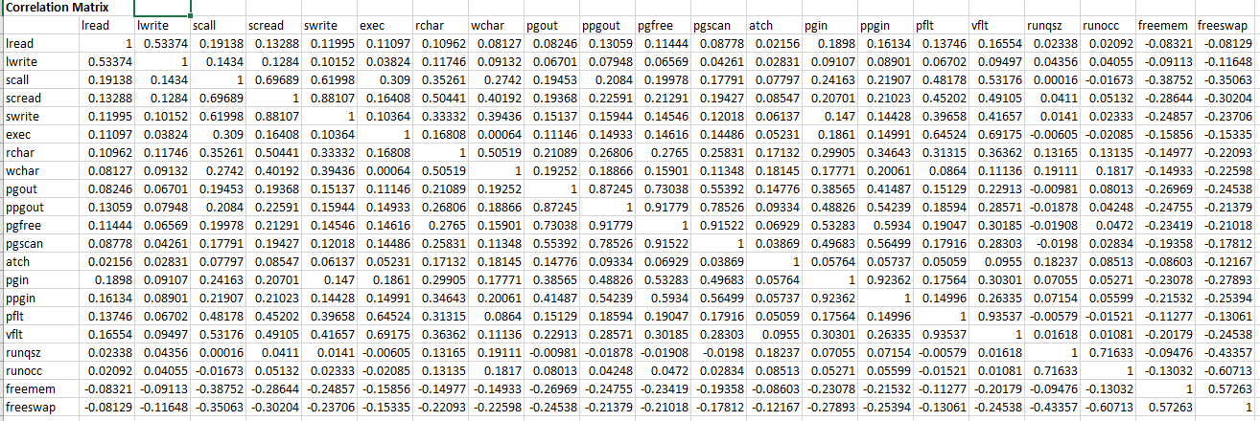
Principal Component Analysis
The main purposes of a principal component analysis are the analysis of data to identify patterns and finding patterns to reduce the dimensions of the dataset with minimal loss of information.
Used when the independent variables are correlated.

Slide 6
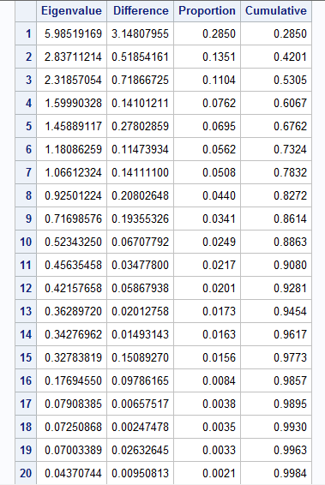
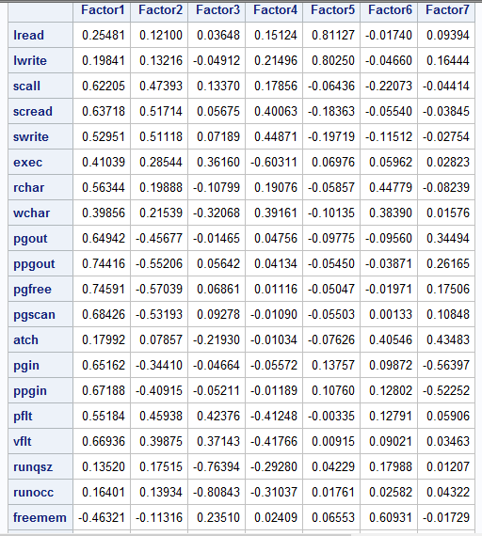
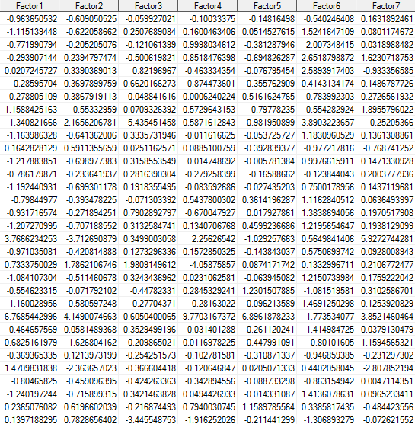
Output Analysis
Eigen Values
Factor Pattern
Principal Components

Slide 7
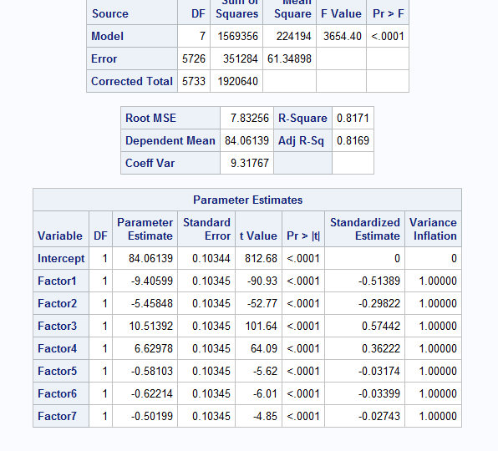
Principal Component Regression
Dependent Variable: sys - Portion of time (%) that cpus run in system mode
Independent Variable: Principal Component 1 - Principal Component 7

Slide 8
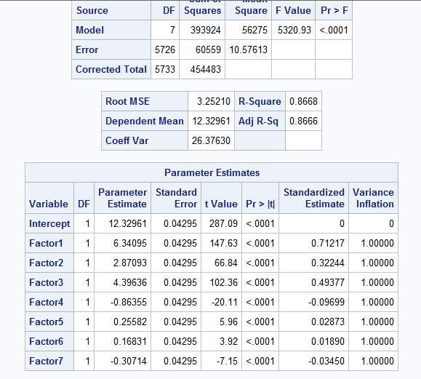
Principal Component Regression
Dependent Variable: usr- Portion of time (%) that cpus run in user mode
Independent Variable: Principal Component 1 - Principal Component 7

Slide 9
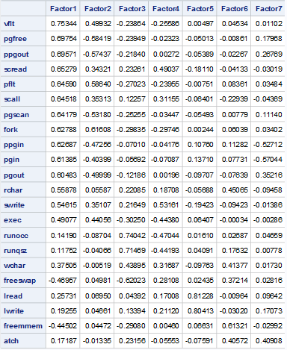
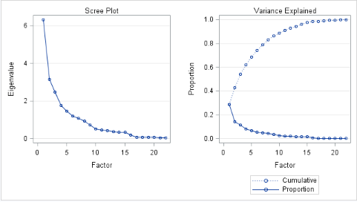
Factor analysis
Before rotation

Slide 10
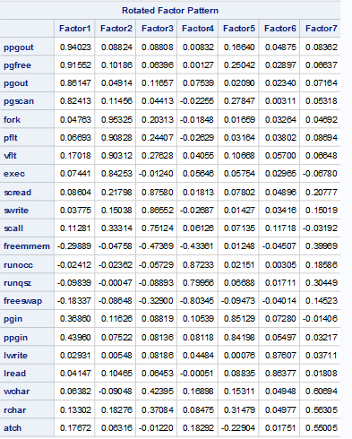


Varimax rotation

Slide 11
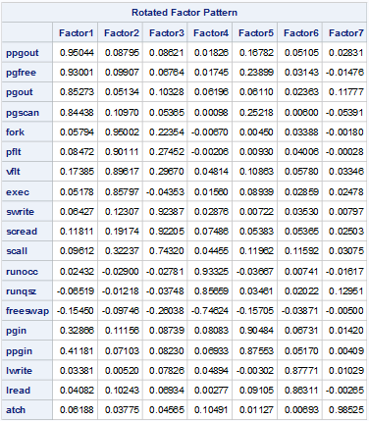

Dimensionality reduction
We have removed the variables with a main loading min cutoff .50 and cross loading max cutoff of .3
Freemen, wchar and rchar variable were removed.

Slide 12
Building a regression model
Factors:
lread, lwrite, scall, scread, swrite, fork, exec, pgout, ppgout, pgfree, pgscan, atch, pgin, ppgin, pflt, vflt, runqsz, runocc, freeswap,
Predicted variables:
Usr
Sys

Slide 13
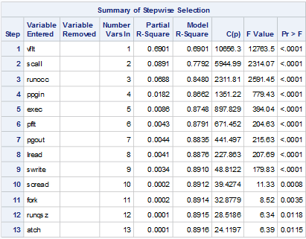
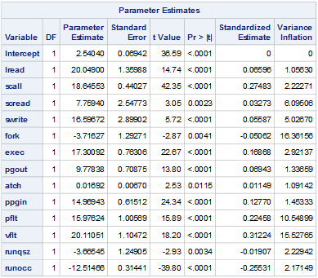
Regression model for sys

Slide 14
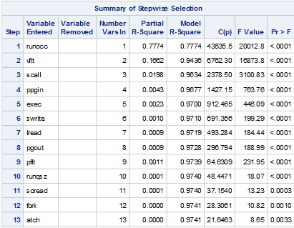
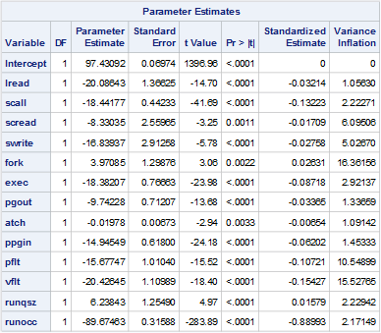
Regression model for usr

Slide 15




Comparison of Predicted and Actual Result for PCA
USR SYS

Slide 16




Comparison of Predicted and Actual Result for FA
USR SYS

Slide 17
Comparisons of MAE and RMSE
PCA | Result | FA | Result
MAE usr | 2.149400363 | MAE usr | 2.841863780
RMSE usr | 3.0504854866 | RMSE usr | 4.033195189
MAE sys | 10.202401193 | MAE sys | 2.169344594
RMSE sys | 15.915186959 | RMSE sys | 3.0735914687

Slide 18
Conclusion
As observed, the MSE and RMSE for sys mode using PCA is high, therefore we would recommend using Factor Analysis Model for prediction of usr and sys.

Slide 19
THANK YOU

